Slide 1
Azure Virtual Machines

Slide 2
IaaS Cloud Services
Azure Virtual Machines is one of several types of on-demand, scalable computing resources.
VM is a part of Infrastructure as a Service.
IaaS is an instant computing infrastructure – quickly scale up and scale down

Slide 3
Business Scenarios for IaaS
Test and Development
Website hosting
Storage, backup and recovery
Web apps
High-performance computing
Big data analysis
Extended Datacenter

Slide 4
Planning Checklist
Start with the Network
Name the VM
Decide the location for the VM
Determine the size of the VM
Understanding the pricing model
Storage
Select an operating system

Slide 5
Start with Network
Virtual networks (VNets) are used in Azure to provide private connectivity between Azure Virtual Machines and other Azure Services

Slide 6
Name the VM
Element | Example
Environment | Dev, prod, stage, QA
Location | Uw, ue
Instance | 01, 02, 03, 04, 05
Product or Service | service
Role | Sql, web, messaging
Devusc-webvm01 – first development web server hosted in the US South Central location

Slide 7
Location
The location can limit your available options
There are price differences between locations

Slide 8
Pricing
Compute Costs Priced on a per-hour basis but billed on a per-minute basis
Consumption Based
Reserved Virtual Machine Instance
Storage Costs You are charged separately for the storage VM uses

Slide 9
Virtual Machine Sizing
General Purpose
Compute Optimized
Memory Optimized
Storage Optimized
GPU
High Performance Compute
Note: Be cautious when resizing production VMs

Slide 10
Virtual Machine Disks
OS Disk
Temporary Disk – Non-persistent storage
Data Disk

Slide 11
Supported Operating System
Windows
Linux

Slide 12
Connect to VM
Windows – RDP - 3389
Linux – SSH - 22

Slide 13
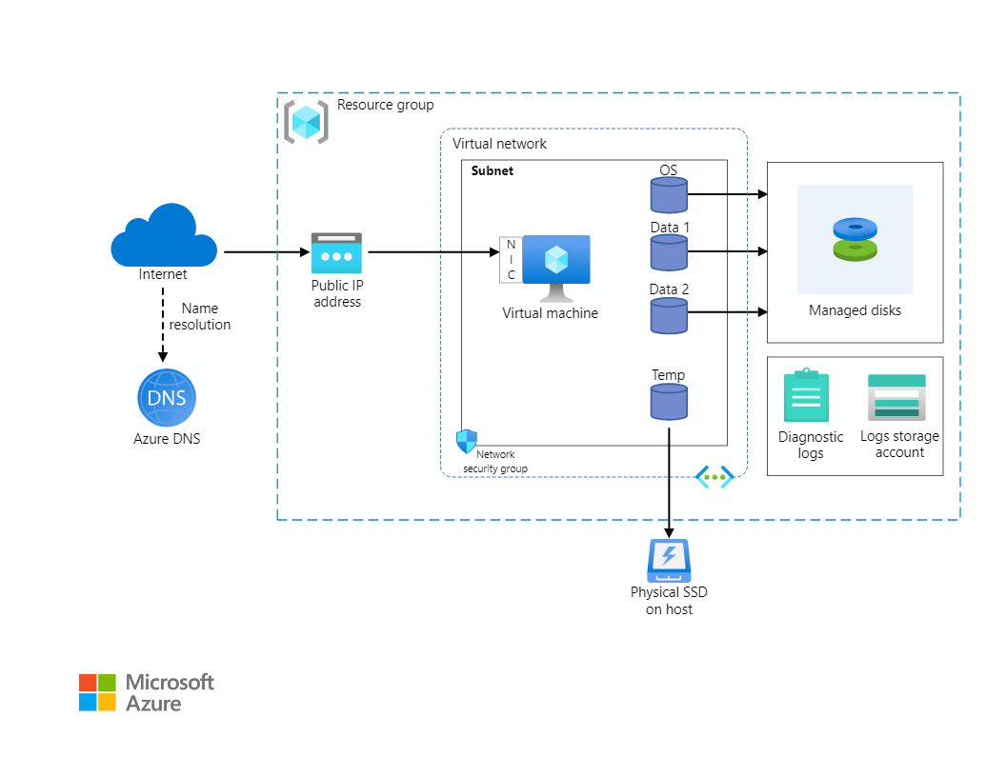

Slide 14




VM
Power Off
Pause
Hibernate
Close the RDP
Shutdown
Stop from Portal
Terminate
Deallocate

Slide 15




VM
Stop Azure Portal
Deallocate
Suspend
Shutdown
Power Off
Close the RDP

Slide 16
Virtual Machine Availability

Slide 17
Maintenance and Downtime
Unplanned Hardware Maintenance – Live Migration
Unexpected Downtime - Heals
Planned Maintenance – Periodic Updates

Slide 18





High Availability
Availability Sets
Availability Zones
Virtual Machine Scale Sets

Slide 19
Availability Sets
Logical feature used to ensure that a group of related VMs are deployed so that they are not all subjected to single point of failure
VMs placed in an availability set should perform an identical set of functionalities.

Slide 20




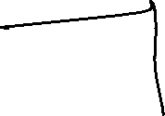



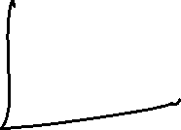

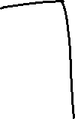



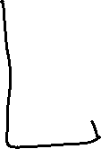








Slide 21
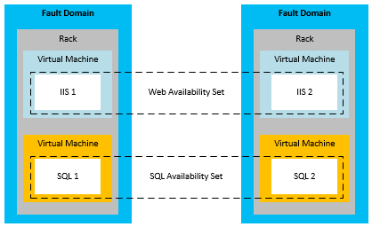
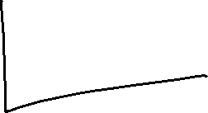


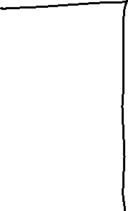

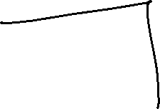


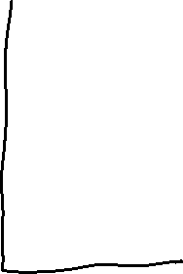



Slide 22
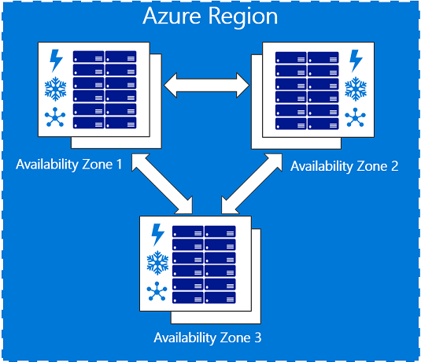

Availability Zones

Slide 23
SLA
Single VM with a Premium Disk – 99.90%
Availability Sets – 99.95%
Availability Zones – 99.99%

Slide 24





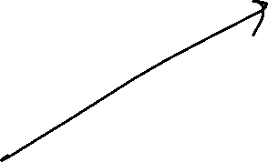







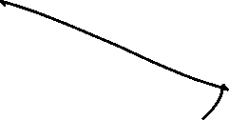


Virtual Machine Scale Set
Azure compute resource you can use to deploy and manage a set of identical VMs.
True auto scale, no pre-provisioning of VMs required.

Slide 25
Benefits of VMSS
Same base OS image and configuration
Azure load balancer – layer 4 and application gateway – layer 7
Scale set allows to run multiple instances of application
Customer demand can be met
Scale set supports upto 2000 VMs instances.

Slide 26
Autoscale
Scale In
Scale Out
Schedule events
Less overhead

Slide 27


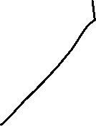


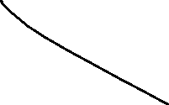




Enable RDP under networking in VMSS
Go to Load Balancer -> Inbound NAT Rules
Connect to VM using RDP : IP:Port Ex: 172.172.139.109:5000
You will be connected to the VM

Slide 28





















